Slide 1
CS 499/579 Special Topics: Enterprise Defense
Dave Nevin, Asst. Professor of Practice
Brandon Ellis, Asst. Professor of Practice
Matt Ruff, Asst. Professor of Practice
January 9, 2024

Slide 2
Why this class?
Enterprise Defense is a highly marketable skill
It will be helpful for students pursuing the ORTSOC track
Potential future replacement for CS 373 (this is an initial test run)
&
It didn’t seem fair to not have a Corvallis campus offering of CS 373 this year when it is a required class for the new option.
(oh, and I decided to slash it so Grad Students could have fun too)
Notes:
Disclaimer—we’ve had 1 month to prepare for this class. It involves coming up with completely new curriculum, and a multiple server lab environment. Complaints about lack of organization will be ignored. We will adapt what we’re doing based on our observations of your behavior. And I will never count against you for something that we didn’t do well.

Slide 3
About your instructors…

Slide 4
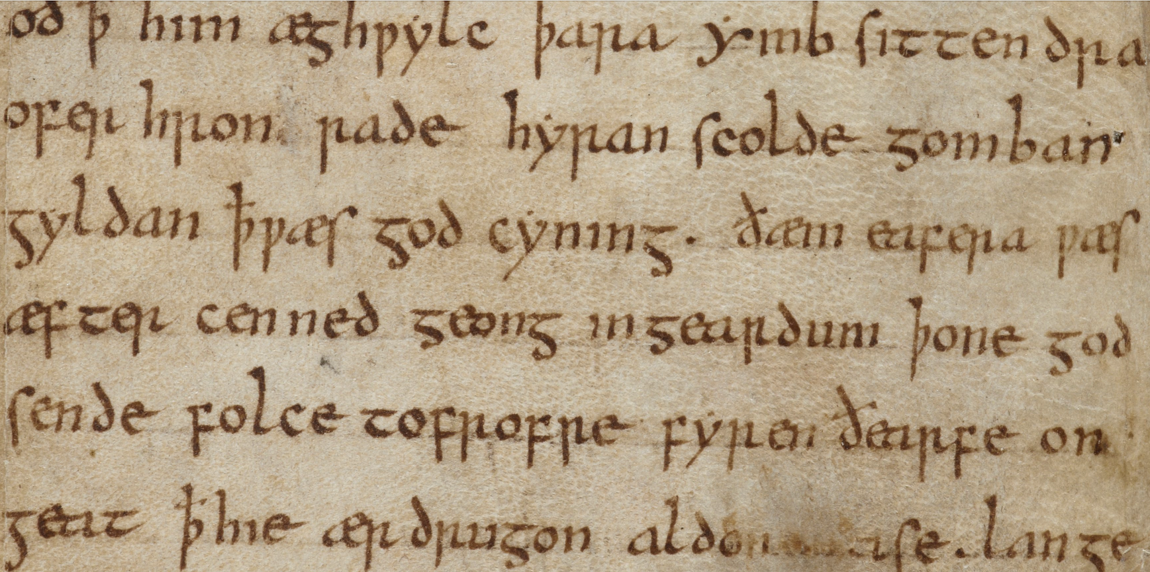
Dave Nevin
BA, MA, ABD English Literature
Minor in physics
Computer-intensive research on Old English language
Taught classes on use of computers in study of literature
3 decades of IT experience
Decided to specialize in Cybersecurity ≃ 2000.
CISSP since 2004
1,000+ hours of continuing professional education credit in cybersecurity topics
Certified Computer Forensics Technician in 2006
OSU’s first ”real” CISO
Established the Office of Information Security in 2012
Established the (proto) ORTSOC in 2015
Joined the EECS faculty as an instructor in 2019
Joined the EECS faculty full-time as a Professor of Practice and Director of ORTSOC in 2021
REN-ISAC Peer Assessor, Higher Education Information Security Council Leadership Team Member, etc., etc.
Notes:
For those interested in specifics, my research in the area were mostly done in a now archaic language called SNOBOL, which was particularly well suited for user-defined pattern-matching expressions—looking at the small sample above you can see that there are special characters that don’t fit within an ASCII character set, so we had to program those in. I was specifically looking to identify authors and/or scribes of different works based on language usage.

Slide 5
Brandon Ellis
BS/MS in Computer Science from OSU
Member of ORTSOC Core design team
Active member/officer/participant in OSUSEC CCDC, CTPC, etc. teams
Penetration Testing/Red Team Mentor @ ORTSOC

Slide 6
Matt Ruff
MS – Cybersecurity Analytics & Operations
BS – Security & Risk Analysis
Both from Penn State University
Former Diplomat (U.S. Dept. of State)
Former CIA – Technical Operations Officer / Cyber Operations Officer
Former Booz Allen Hamilton Employee

Slide 7
What we’ll be doing this term…
First 3 (or so) weeks (traditional classroom)—
Learning about Enterprise Architecture
Learning about common tactics to defend that Architecture
Basic (applied)networking refresher
Basic intro to attacker tactics/tradecraft
Mid-term

Slide 8
Following the mid-term
Labs!
Break out into teams
We’ll make the teams.
Introduction to virtual environments
Auditing, hardening and applied security architecture
Attack of the Instructors #1, presentation of findings
Lather, rinse, repeat
Board of Directors presentation
Live, spectacular, final event (during Week 10)

Slide 9
Our expectations
Attend, participate, do well.
Do not end up in jail.
Work as a part of a team. Engage your teammates.
No Cowboys!
We’re going to pwn your systems.
We’re going to totally own them multiple times.
That’s how you’ll learn.
Get over it.
Have fun! (I know we will…)

Slide 10
How we’ll determine your grade…
Tests/exams/quizzes (duh)
Journal (following mid-term)
Attendance & Participation
If you show up and don’t do anything but sit there, you probably shouldn’t expect to get any points for attendance.
If you are going to be absent, let us know in advance (through Canvas) so we arrange make-up
Don’t show up sick.
Graduate students are required to read a weekly research paper and submit a review (assigned through Canvas)

Slide 11
Come see us!
Dave’s Office hours:
Wednesdays, 1-3pm and by appointment
KEC 3075
Brandon’s Office hours:
Monday/Friday 12-1pm
KEC 3065
Matt’s Office hours:
Tues/Th 10-11am
KEC 3065

Slide 12
Questions?

